Slide 1
Bike Sharing Analysis Dashboard Prepared By: Vijendra Vaishnav
Microsoft Excel Project

Slide 2
Project Objective
1.Analayze Bike Sharing Data.
2.Cleane And Preprocess The Data.
3.Merge Multiple Datasets.
4.Creating Dashboards

Slide 3
Datasets Information
Dataset_1
Dataset_2
Dataset_3
Merge_Data_A
Finally Merged Dataset
989 Records
17 Columns

Slide 4
Data Preprocessing
Remove Duplicats
Checked Missing Value
Apply Sort & Filter
Merged DataSets Using Power Quary
Create Final Data Sets

Slide 5
Charts
Monthhly Trand
Season Wise
Casual vs Registered
Weather Analysis
Hourly Trend Etc.

Slide 6
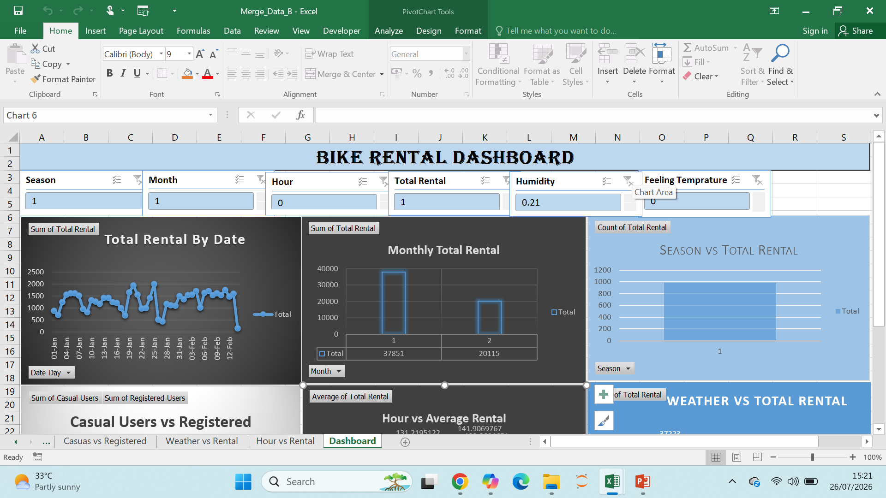
Interactive Dashboard with Pivot Table, Charts , Slicers

Slide 7
Key Insights
Rental Demand Varied Across Seasons.
Weather Affected Bike Rentals.
Peak Rental Occurred During Specific Hours.
Monthly Trends Showed in Demand etc.
The final Dataset Contain (989 Rows) With A Total Of 57966 Bike Rental.

Slide 8
Conclusion
Successfully merged 3 datasets into a final datasets of 989 records.
Performed Preprocessing by Removing Duplicates, Cheaking Missing value, Formatting Data ETC.
Performed complete pre-processing using PowerQuary.
Built Excel Dashboard Using Pivot Tables, Pivot Charts , Slicers.
Analyze Rental Trend on Month, Weather, Season, Weekday, Hour, and User.
This Project demonstrate how Microsoft Excel can be used to transform raw data.

